Slide 1
Online Blood Bank management System
Developed By : Anmol Rana

Slide 2
Project Contains
Project Specification
Introduction
SDLC
Data Flow Diagram
E-R Diagram
Data Dictionary
Screen Layout
Limitations
Bibliography
Future Enhancements

Slide 3
Project Specifications
Project Title : Online Blood Management System Front End Tools : Asp.net , MVC, C#, CSS, Java Script Back End Tool : SQL Server Operating System : Microsoft windows 11 Web Server : IIS Web Browser : chrome Editor : Visual studio Hardware : 64-bit processor, 1.70 GHz, 4.00 GB RAM

Slide 4
System Development Strategy
As per the requirement of the project, We have choose
the Spiral as a strategy of developing the project, because
in Spiral-SDLC model starts with a small set of requirement
and goes through each development phase for those set of
requirements, so the appropriate strategy is spiral model.

Slide 5
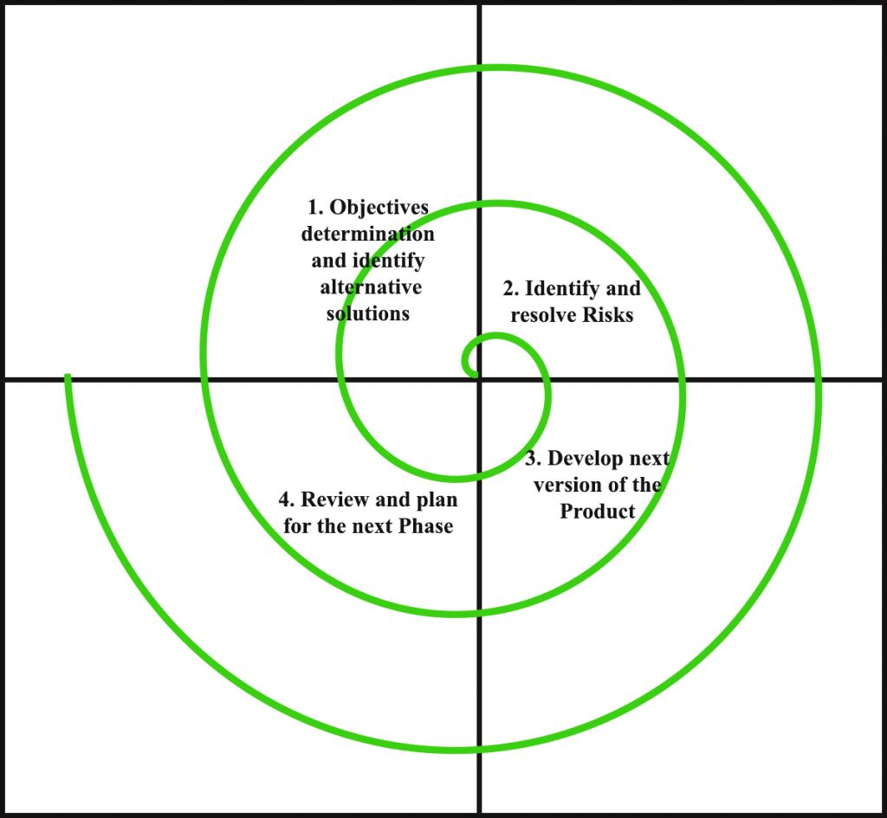
Spiral Module

Slide 6
Data Flow Diagram
A data-flow diagram (DFD) is a graphical representation of the "flow" of data through an information system. DFDs can also be used for the visualization of data processing (structured design).
On a DFD, data items flow from an external data source or an internal data store to an internal data store or an external data sink, via an internal process.

Slide 7
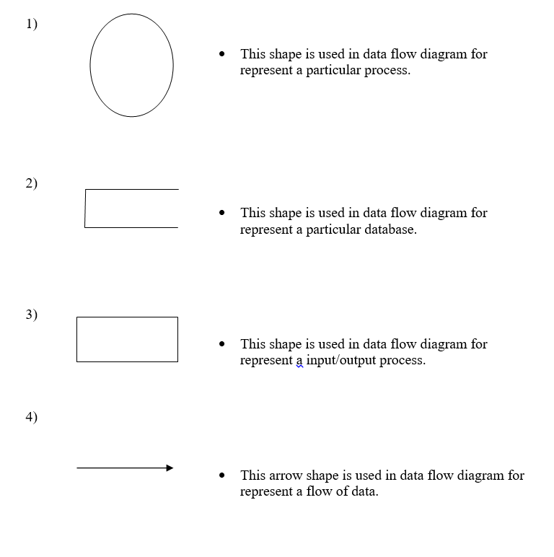

Slide 8

Home Header

Slide 9

Home footer

Slide 10

About Us

Slide 11

Gallery

Slide 12
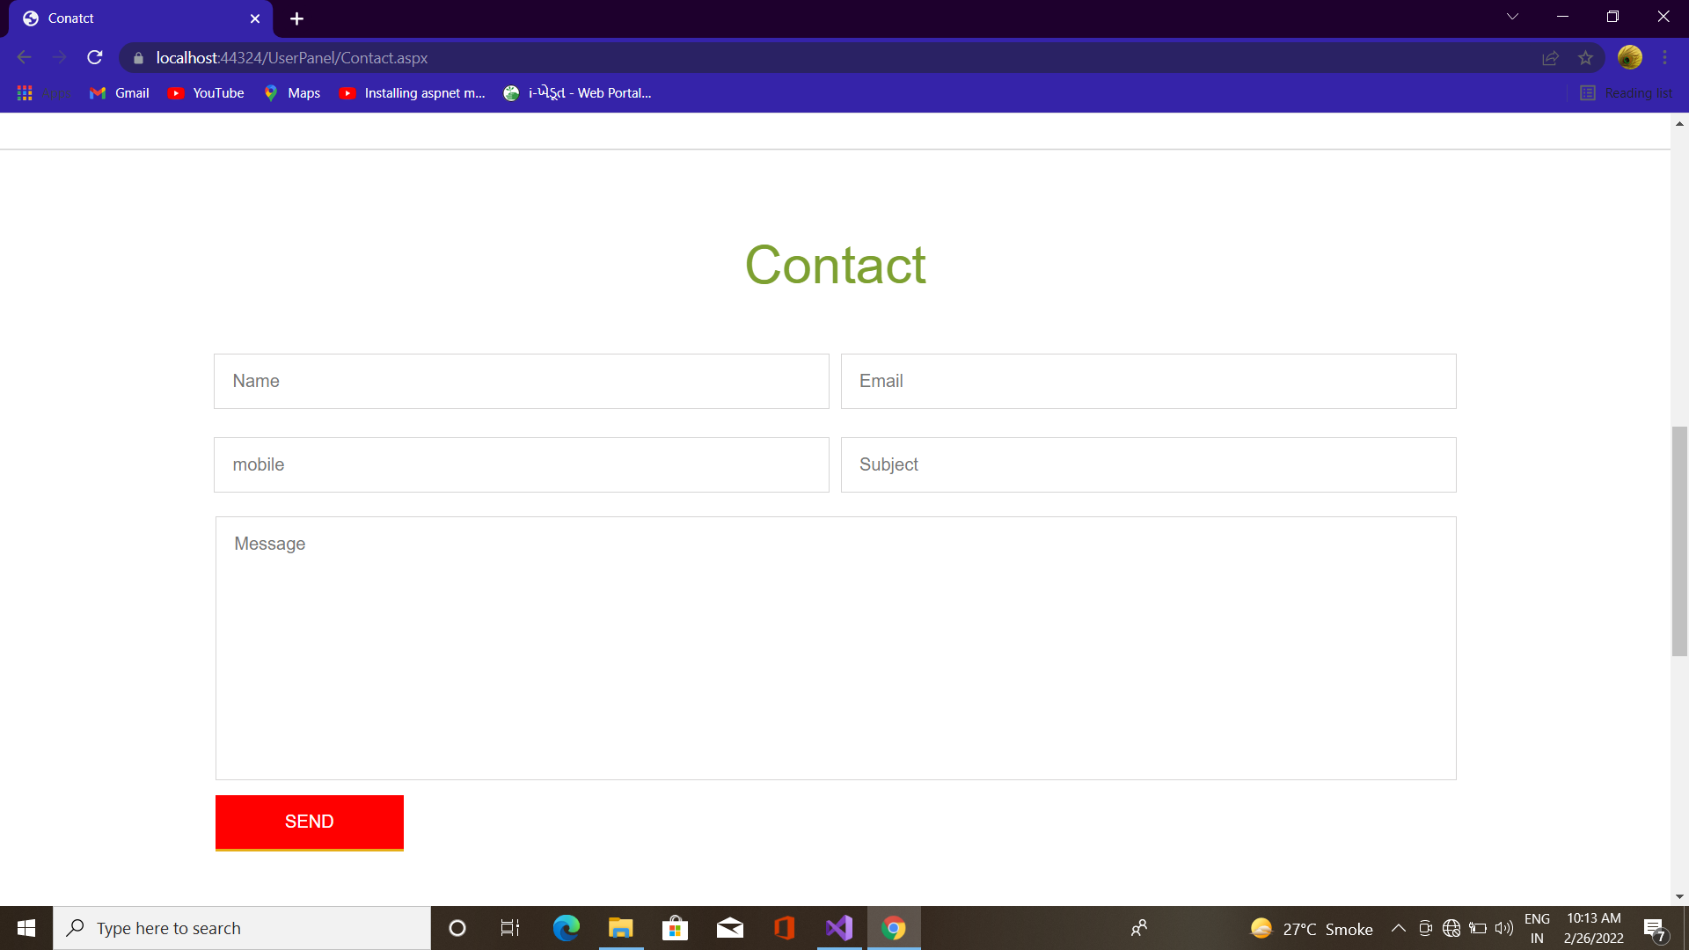
Feedback & Contact

Slide 13
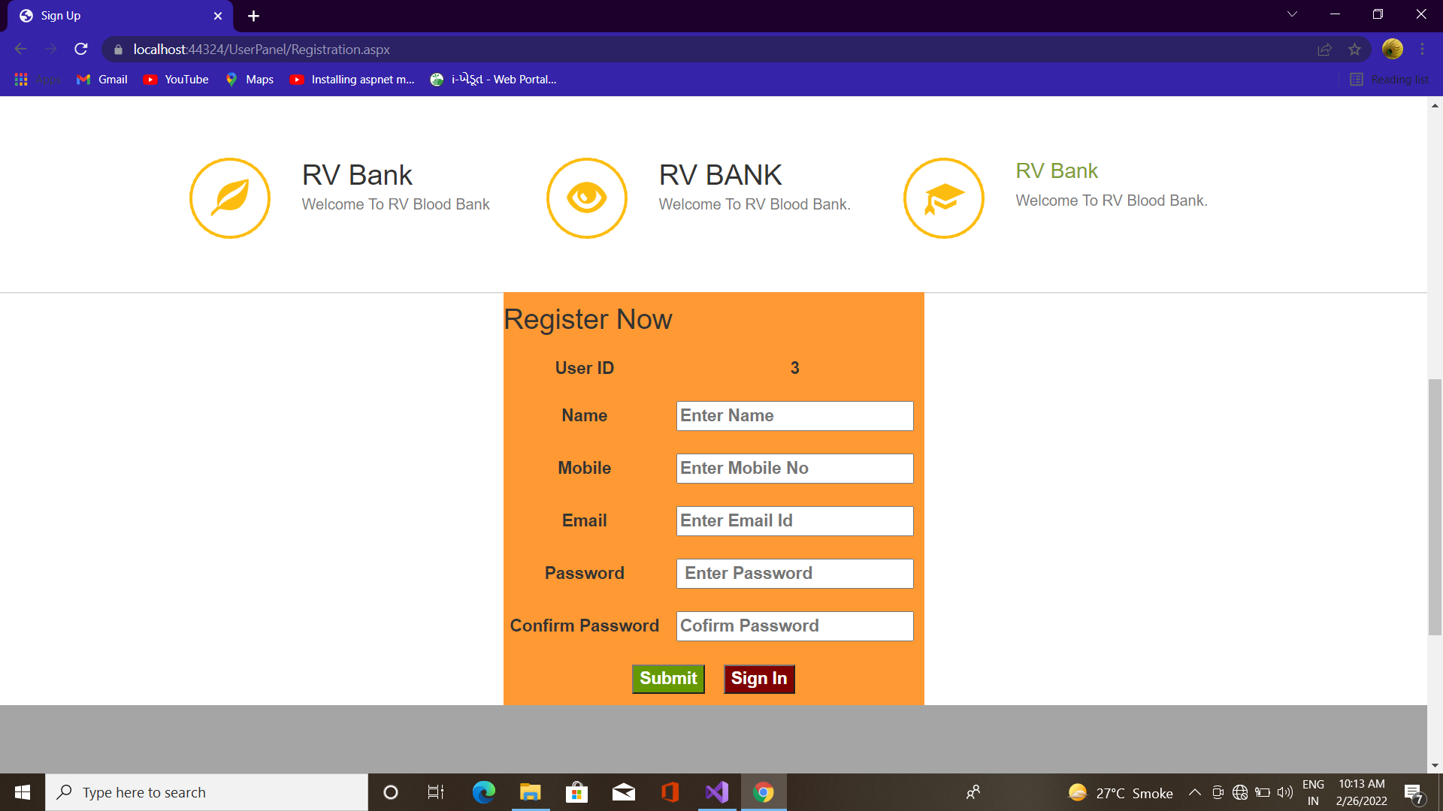
Registration

Slide 14
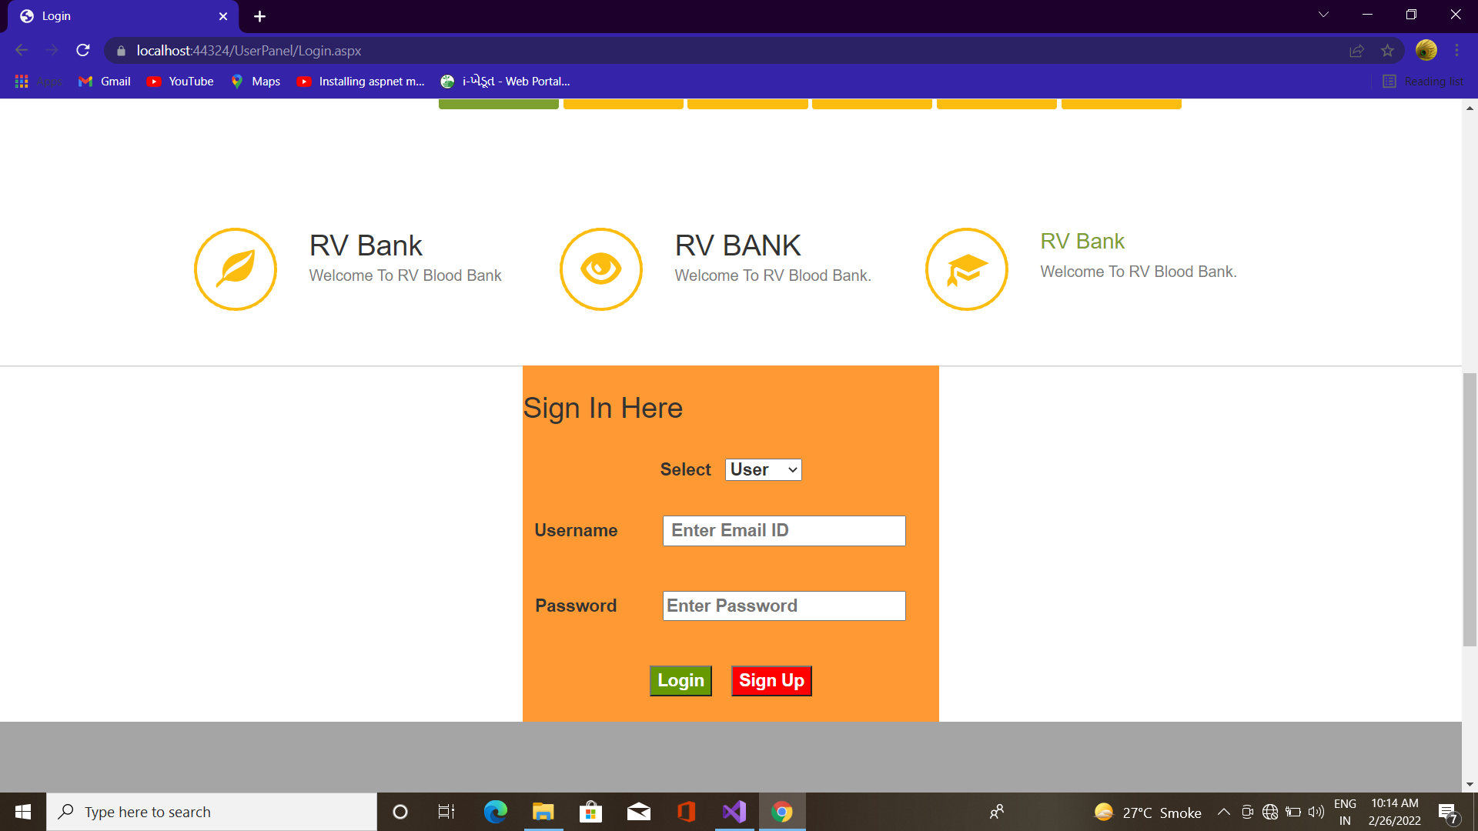
Login

Slide 15
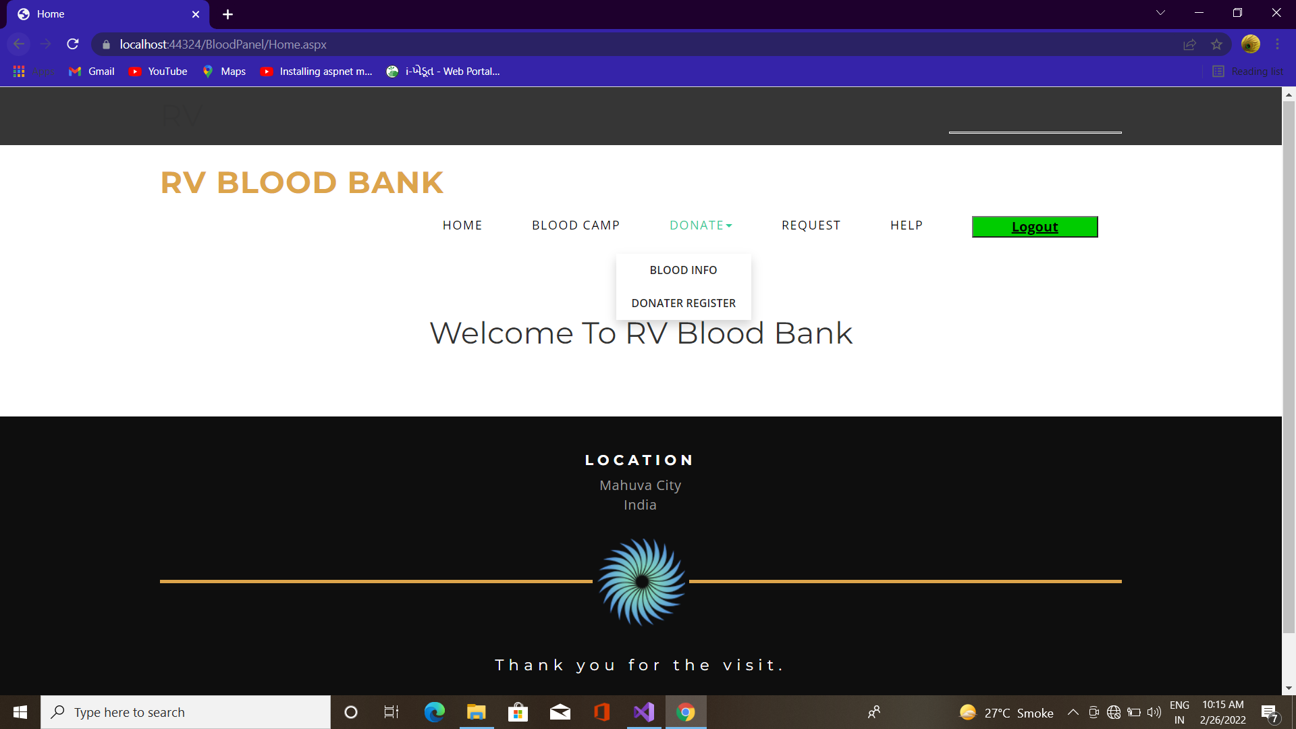
Bpanel Home

Slide 16
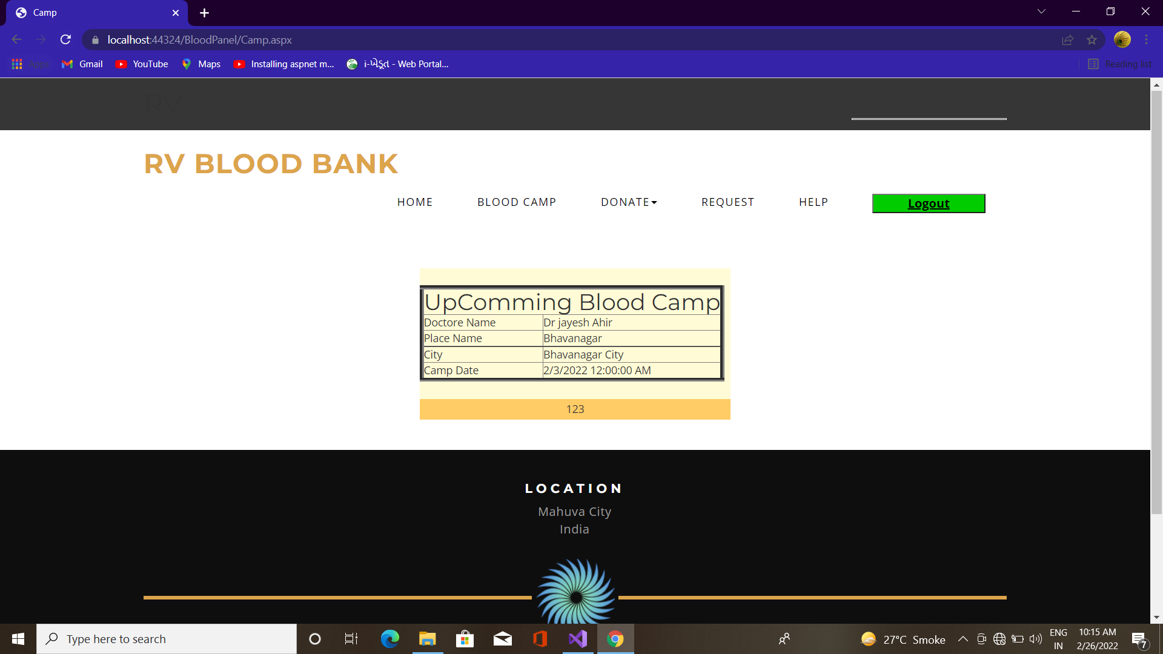
Blood Camp

Slide 17
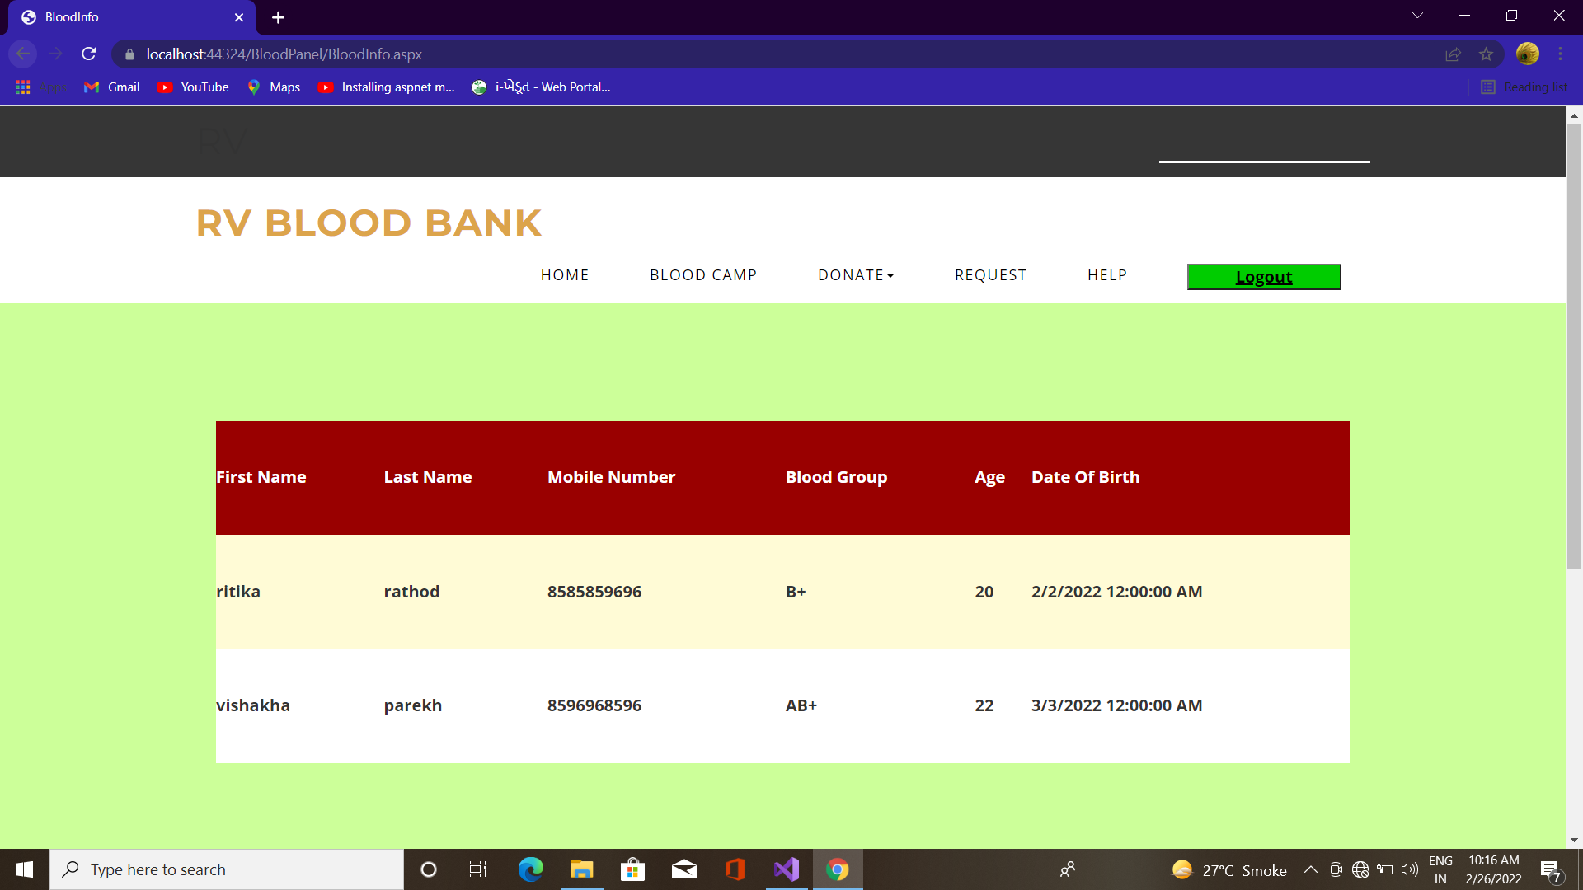
Blood Info

Slide 18
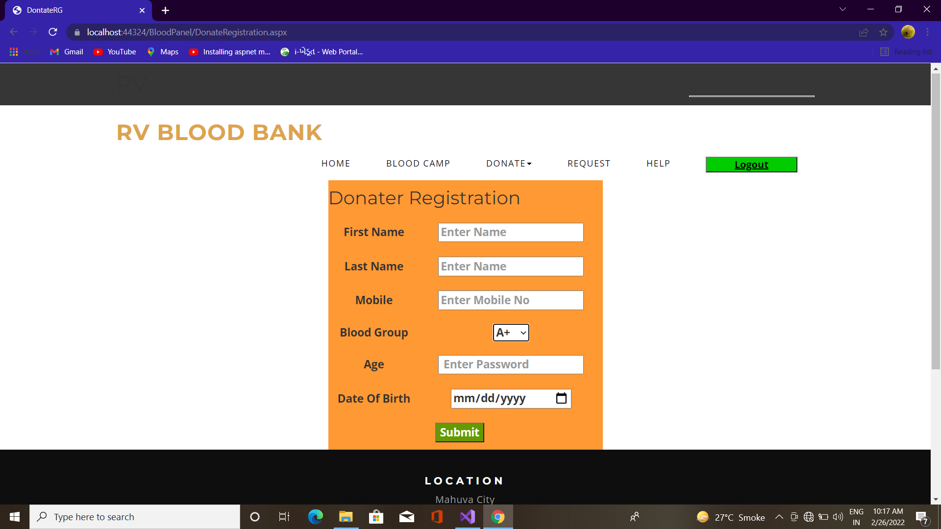
Donator Registration

Slide 19
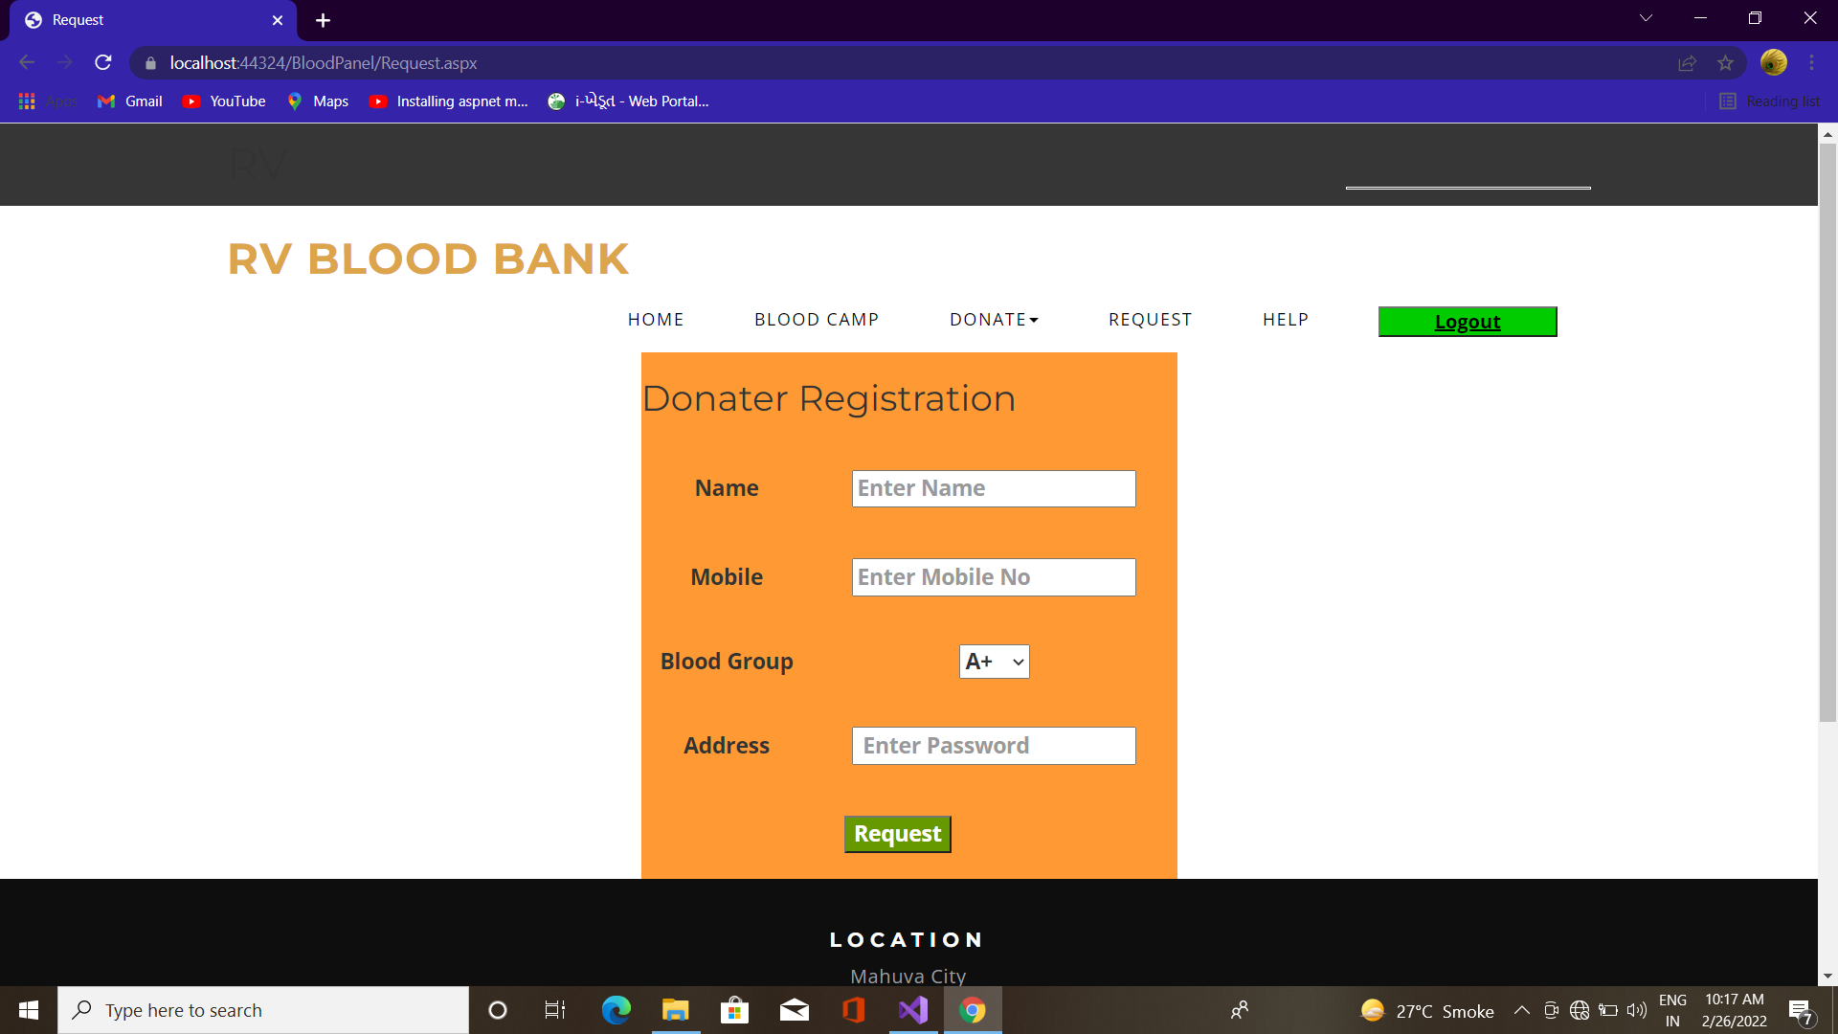
Request

Slide 20
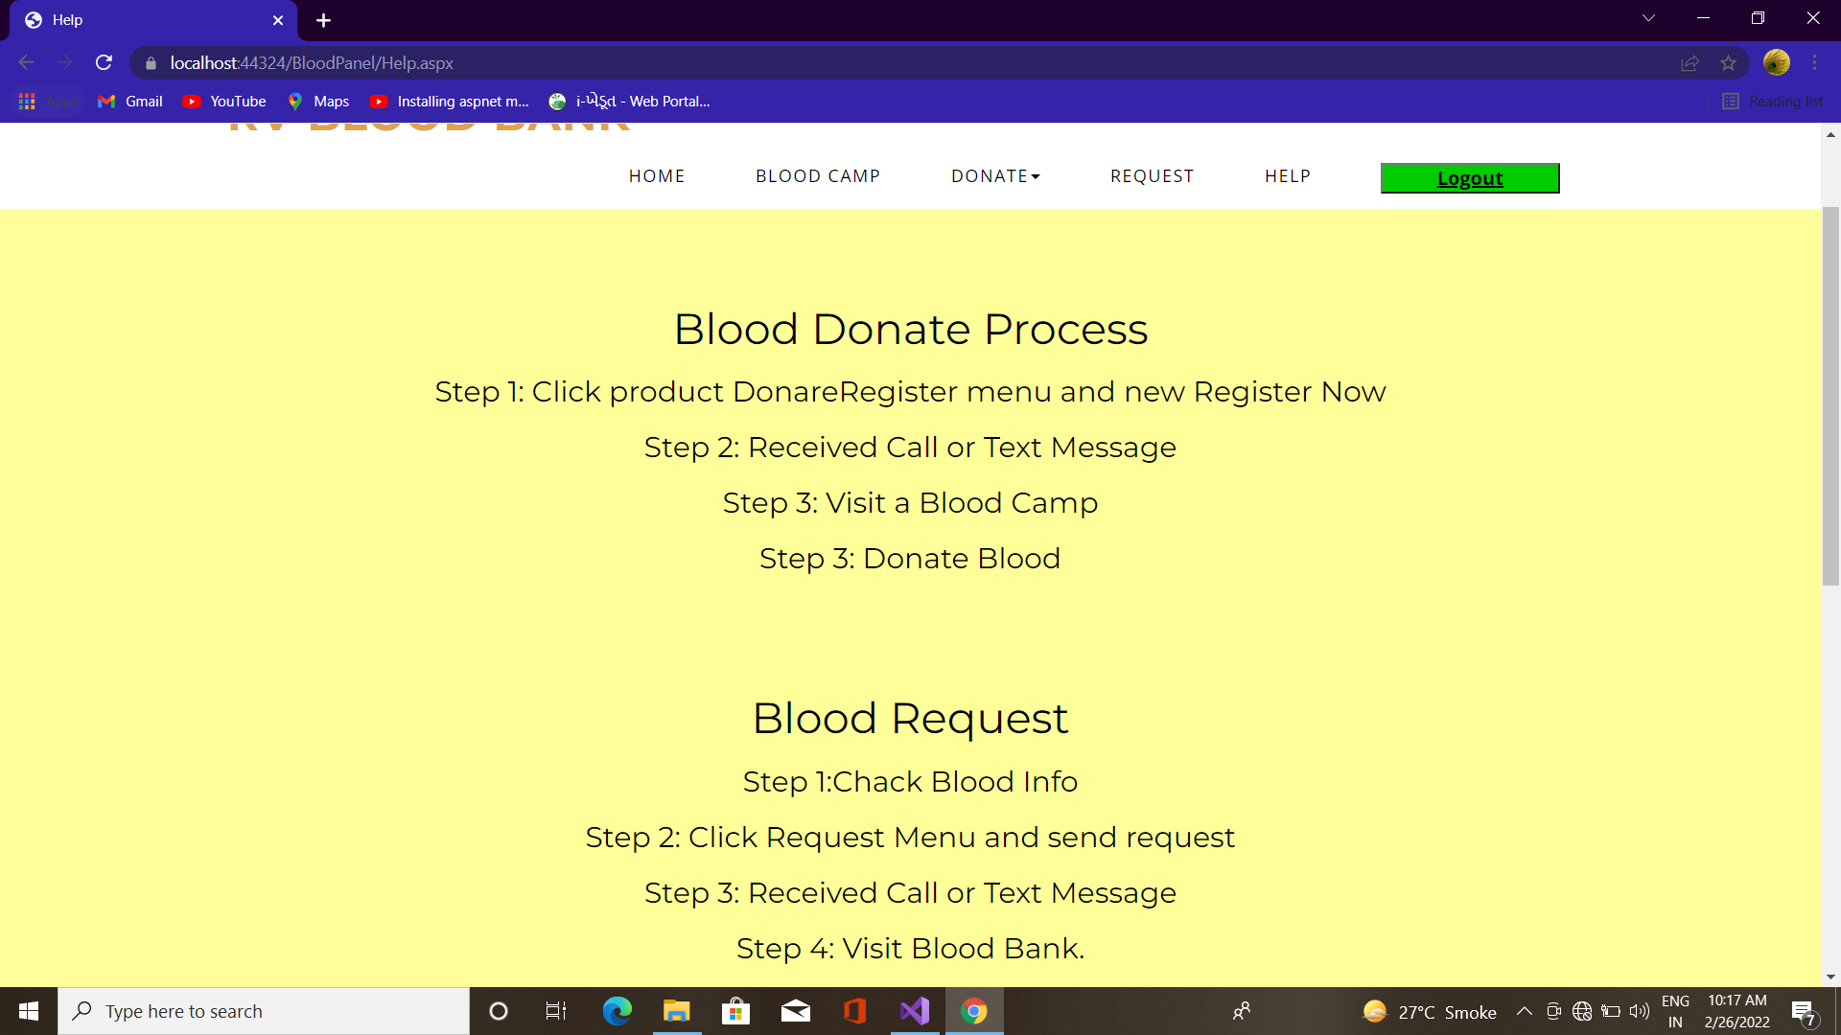
Help

Slide 21
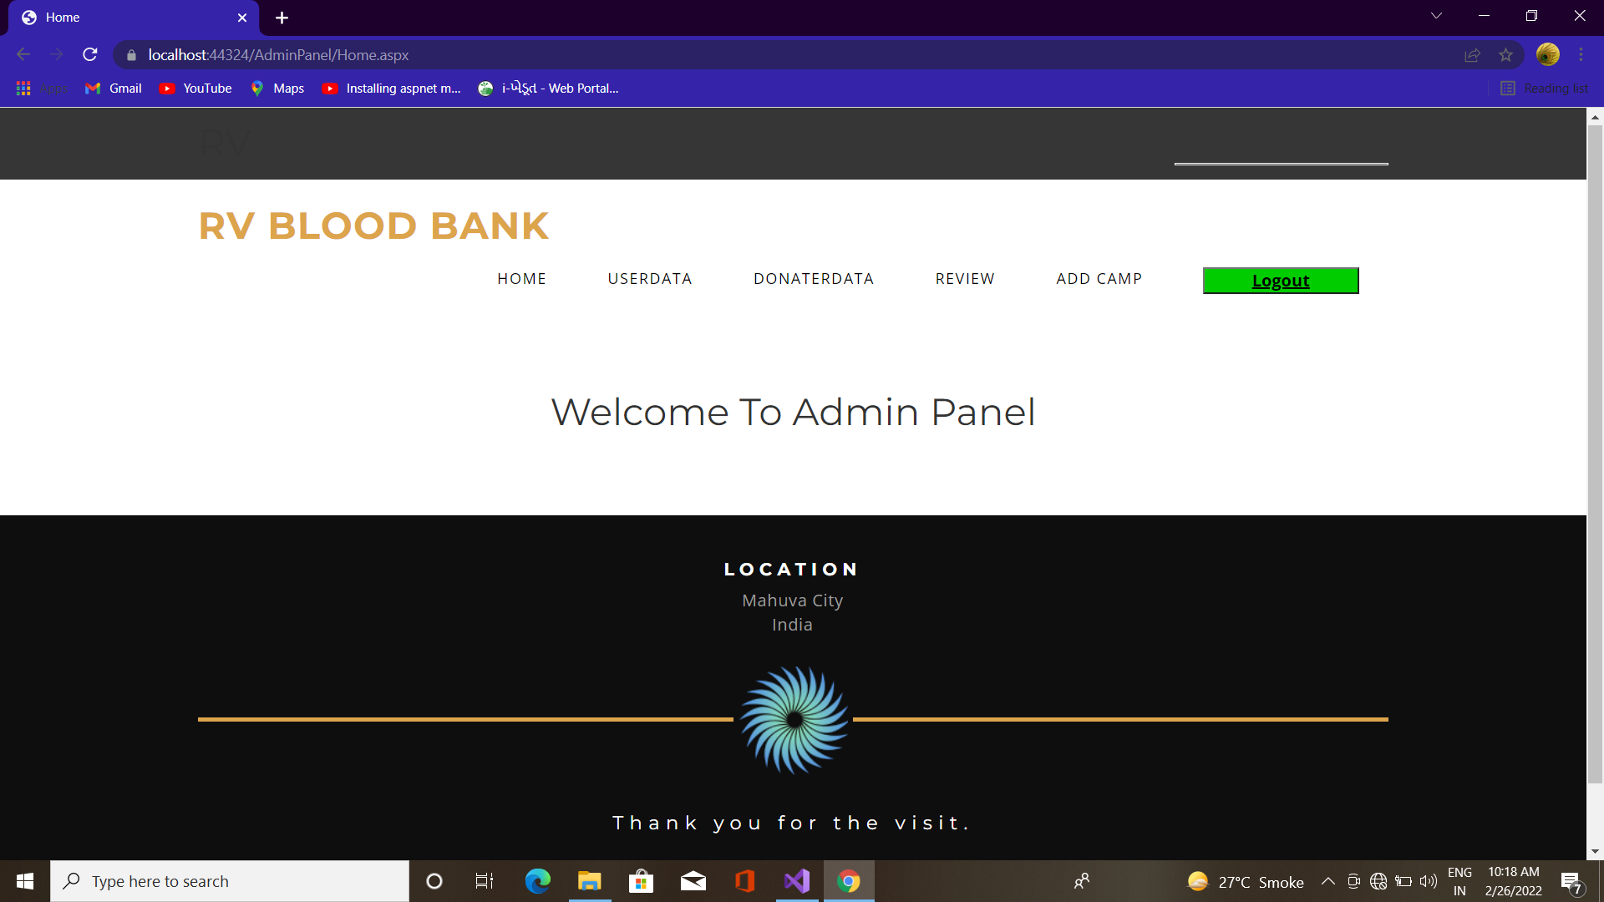
Admin Home

Slide 22
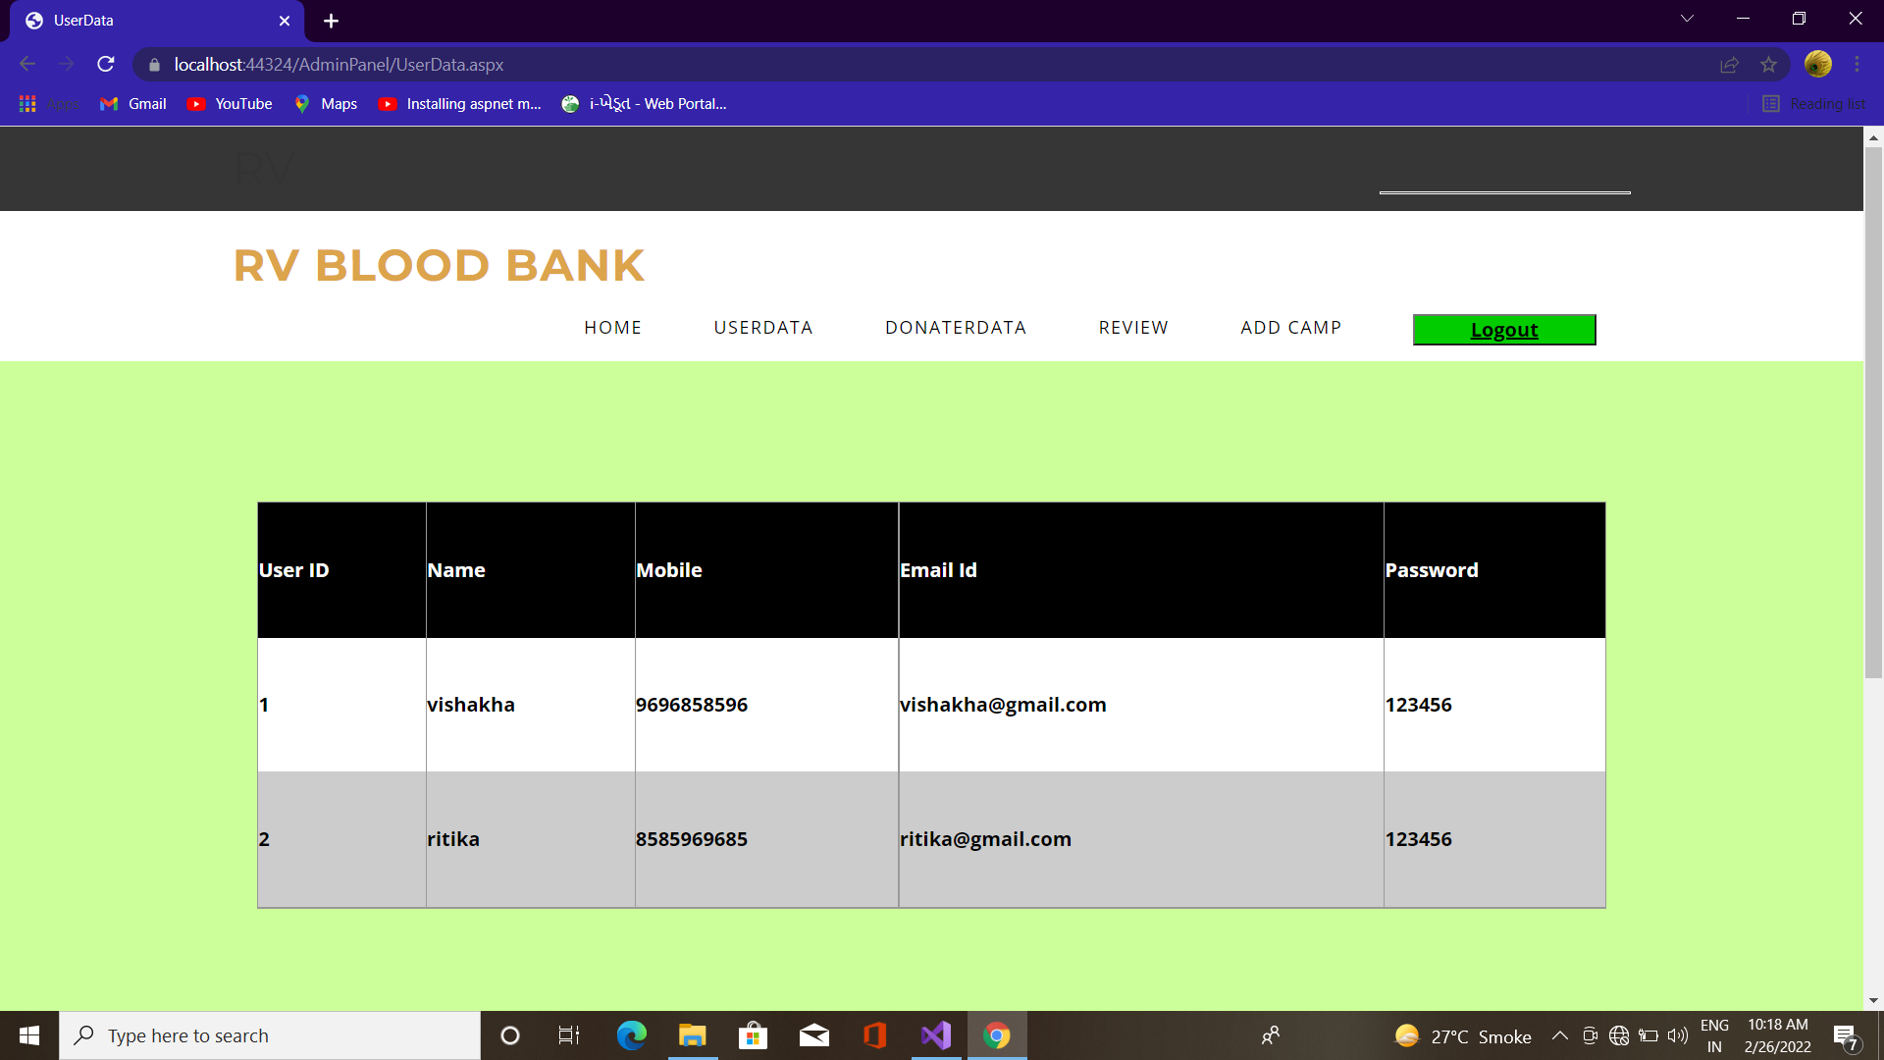
User Data

Slide 23
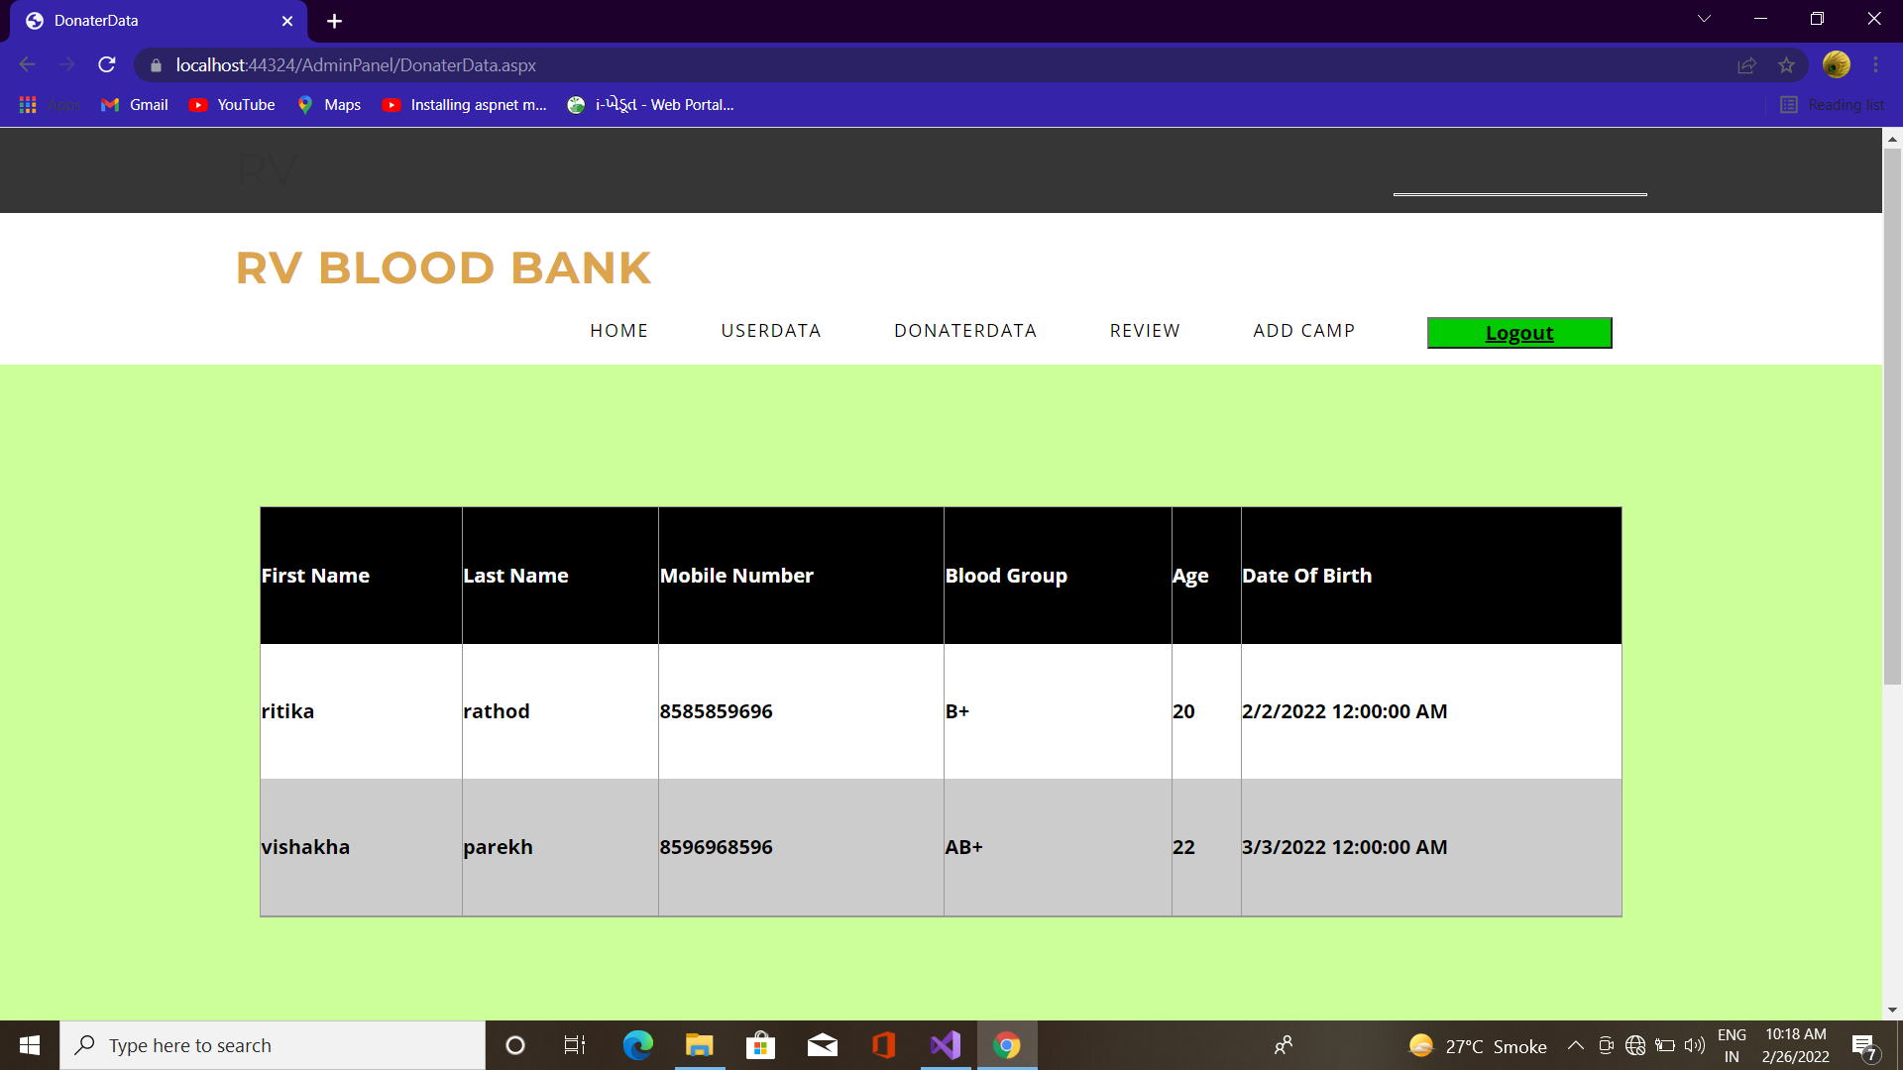
Donate Data

Slide 24
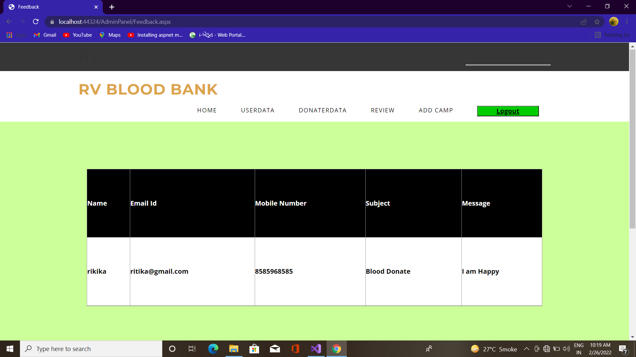
Review

Slide 25
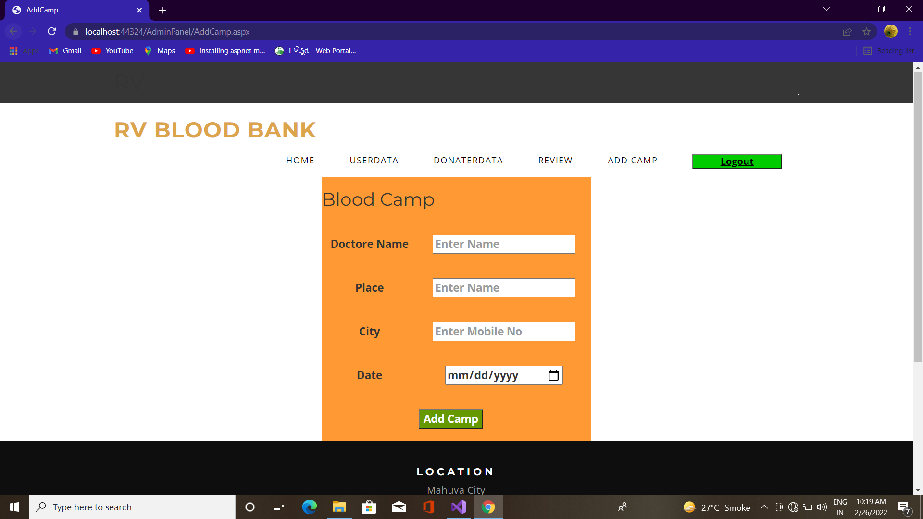
Add Camp

Slide 26
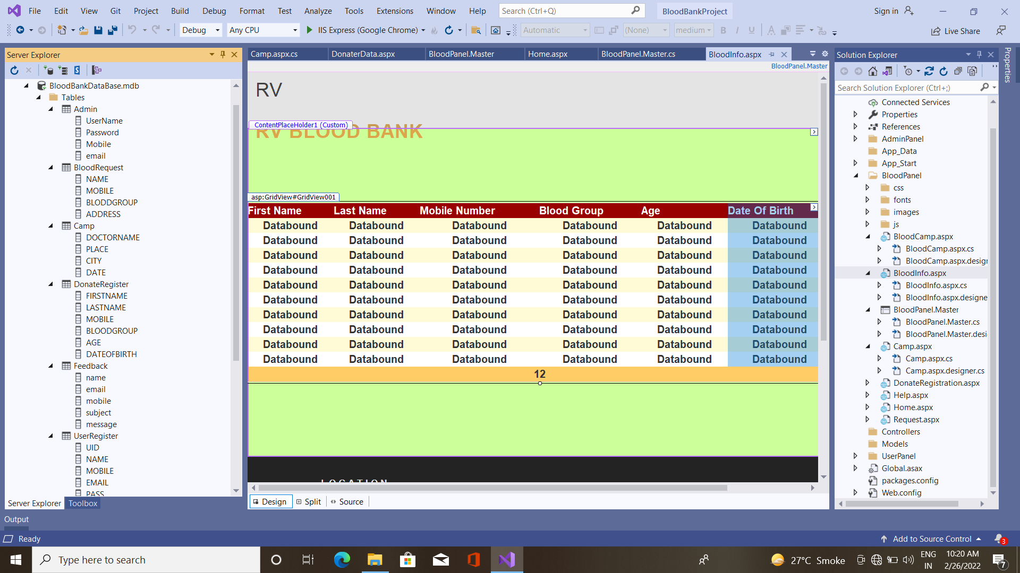
Table Data

Slide 27
Testing and Implementation
Grey Box Testing
Grey Box testing is testing technique performed with limited information about the internal functionality of the system. Grey Box testers have access to the detailed design documents along with information about requirements.
Grey Box tests are generated based on the state-based models, UML Diagrams or architecture diagrams of the target system.
Black Box
White Box
Gray Box

Slide 28
Thank You..!

